Slide 1

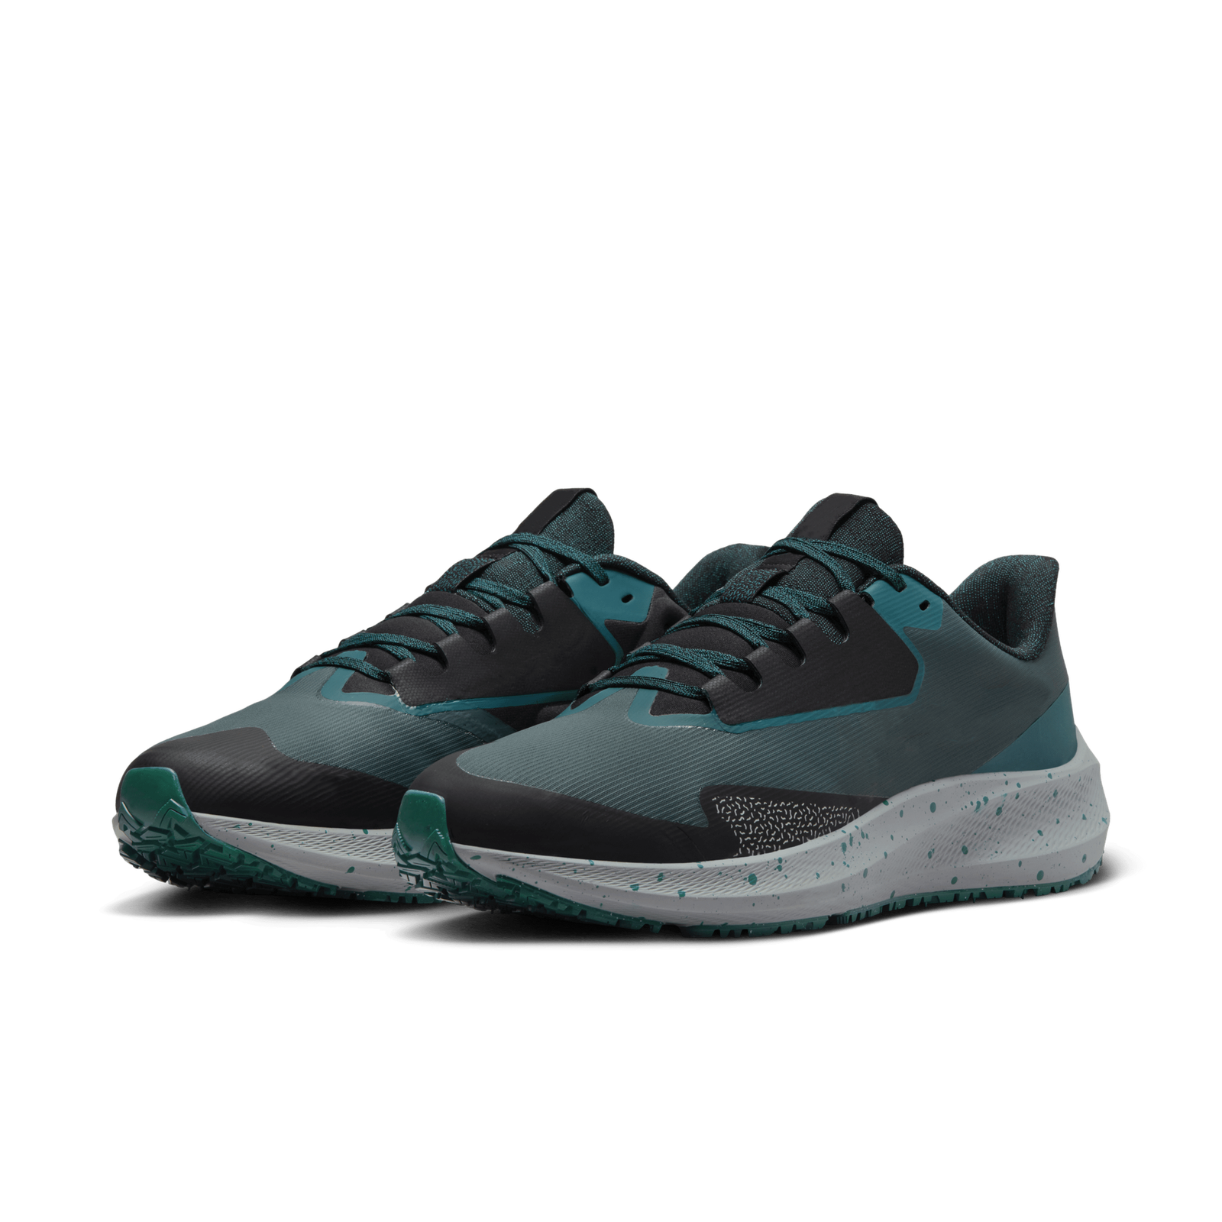
Smart Steps, Bright Paths: Walk into Tomorrow
SMART
SHOE

Slide 2

Group Information
Team Member 1 | ID: | Sec | Intake
Team Member 2 | ID: | Sec | Intake
Team Member 3 | ID: | Sec | Intake
Team Member 4 | ID: | Sec | Intake
Team Member 5 | ID: | Sec | Intake

Slide 3

Table of Contents
01 | Problem Statement | 05 | Required Capital
02 | Features | 06 | Start-Up Plan
03 | Technology Integration | 07 | Outcomes
04 | Methodology | 08 | Conclusion

Slide 4
Problem Statement
Fitness Tracking
Problem: Lack of real-time foot health insights. Solution: Track various health metrics with several sensors.
Gait Monitoring
Problem: Orientation of all the leg segments. Solution: Analyzing the walking or motion to Identify the source of muscle, nerve or skeletal problems.

Slide 5
Features
01 | 02 | 03 | 04 | 05
Feet Pressure | Step Counter | Step Acceleration | Walking Distance | Gait Monitoring
06 | 07 | 08 | 09 | 10
Weight & BMI Measurement | Feet Temperature | Fitness Tracking | Vibration Feedback | User Friendly Application

Slide 6
Technology Integration
Collect Raw Data From Sensors
Store The Data In The Cloud
Process The Collected Data
01
02
03
04
05
06
Machine Learning Algorithms To Predict
Data
Visualization
Get User Feedback

Slide 7
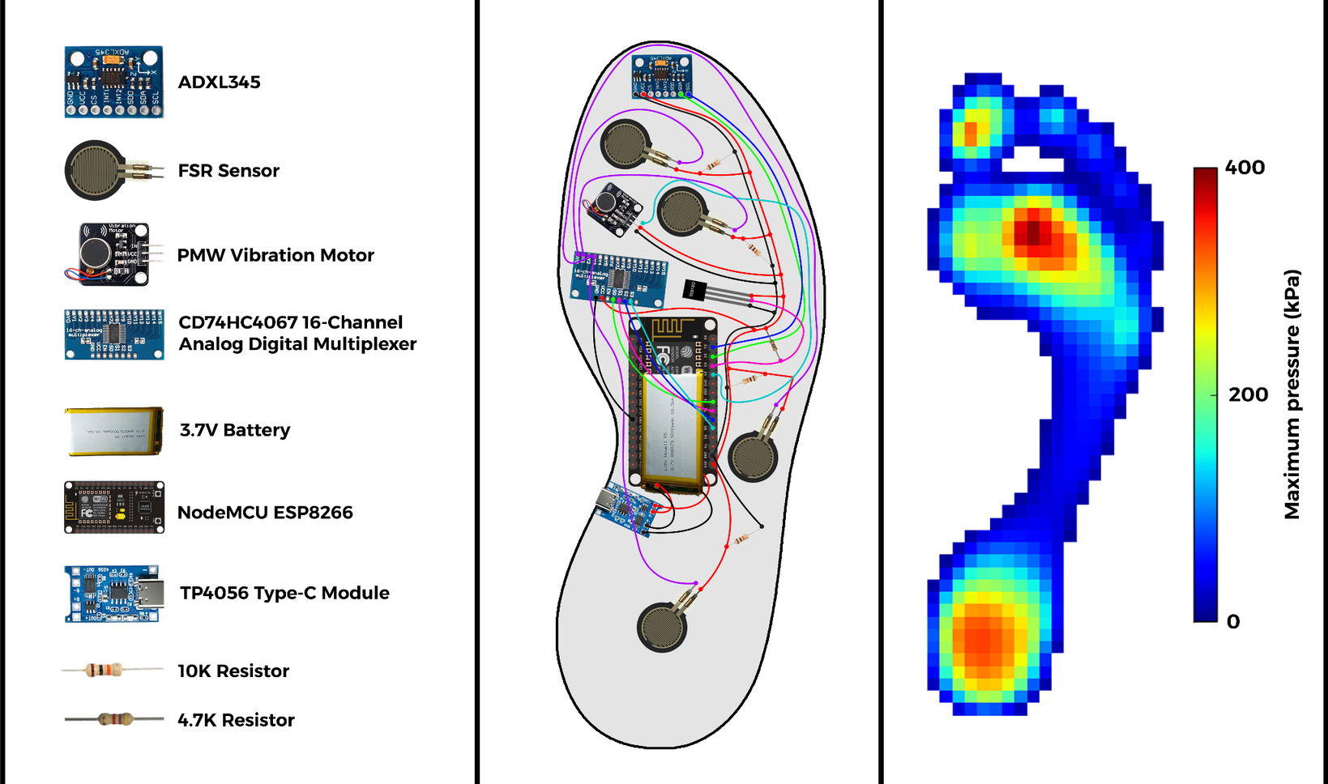
Methodology

Slide 8
Dataset | Dataset | Dataset | Dataset
Time Stamp | 13 attributes for Left Foot | 13 attributes for Right Foot | Weight
Timestamp (ms) Pressure from 1 to 4 sensors (N/cm2) Acceleration in x, y, z axis (g) Angular Rate in ωx, ωy, ωz (dps) Center of Pressure in x, y (related to insole length/width) Total Force (N) Weight | Timestamp (ms) Pressure from 1 to 4 sensors (N/cm2) Acceleration in x, y, z axis (g) Angular Rate in ωx, ωy, ωz (dps) Center of Pressure in x, y (related to insole length/width) Total Force (N) Weight | Timestamp (ms) Pressure from 1 to 4 sensors (N/cm2) Acceleration in x, y, z axis (g) Angular Rate in ωx, ωy, ωz (dps) Center of Pressure in x, y (related to insole length/width) Total Force (N) Weight | Timestamp (ms) Pressure from 1 to 4 sensors (N/cm2) Acceleration in x, y, z axis (g) Angular Rate in ωx, ωy, ωz (dps) Center of Pressure in x, y (related to insole length/width) Total Force (N) Weight
Create Dataset | Create Dataset | Create Dataset | Create Dataset
Train Machine Learning Algorithm | Train Machine Learning Algorithm | Train Machine Learning Algorithm | Train Machine Learning Algorithm
Predict User’s Weight, Gait, Leg Posture and Fitness | Predict User’s Weight, Gait, Leg Posture and Fitness | Predict User’s Weight, Gait, Leg Posture and Fitness | Predict User’s Weight, Gait, Leg Posture and Fitness

Slide 9
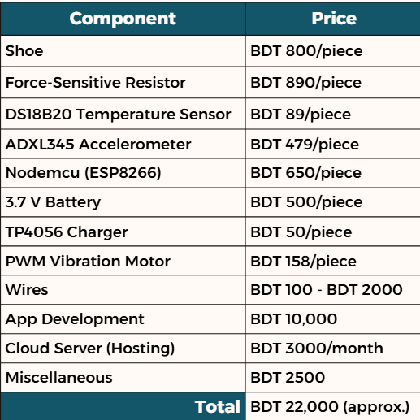

Required Capital
N.B: Prices may vary
1%
100%
60%
100%
The approximate budget we will require for 100 pieces is BDT 2,50,000.

Slide 10




Start-Up Plan
As a start-up business we don’t have enough financial resources, warehouse, lack of equipment so we are reaching out to propose a strategic collaboration between “Smart Shoe Technology” and some shoe companies like ‘Bata’, ‘Apex’ and for athletes ‘Lotto’.
Target Market | Collaboration | Marketing & Sales | Conclusion

Slide 11
Outcomes
Preventive healthcare measures by providing real-time health metrics
Diabetic patients and Gait abnormalities
Optimized training regimens athletes benefit
Decision making to predict weight of user, with access to predictive datasets
Enhanced fitness tracking, leading to improved exercise routines

Slide 12
Conclusion
Emphasizes transformative impact on wearable tech industry
Integration of cutting-edge features allows to collect comprehensive data
Empowering users with real-time data
Blending fashion with technology of wearable tech as stylish daily accessory

Slide 13
Thanks!
Do you have any questions?

